Slide 1
Temperature, heat, and thermodynamics
Physics Unit 6
Notes:
Physics Unit 6

Slide 2
This Slideshow was developed to accompany the textbook
  OpenStax Physics
    Available for free at https://openstaxcollege.org/textbooks/college-physics
  By OpenStax College and Rice University
  2013 edition
Some examples and diagrams are taken from the textbook.
Slides created by
Richard Wright, Andrews Academy
rwright@andrews.edu

Slide 3
06-01 Temperature and Thermal Expansion
In this lesson you will…
• Define temperature.
• Convert temperatures between the Celsius, Fahrenheit, and Kelvin scales.
• Define thermal equilibrium.
• State the zeroth law of thermodynamics.
• Define and describe thermal expansion.
• Calculate the linear expansion of an object given its initial length, change in temperature, and coefficient of linear expansion.
• Calculate the volume expansion of an object given its initial volume, change in temperature, and coefficient of volume expansion.

Slide 4
06-01 Temperature and Thermal Expansion
Do the lab handout.
Three stations, so rotate through them.
Station 1 – Ring and Ball
Station 2 – Bimetallic Strip
Station 3 – Bimetallic Disc

Slide 5


06-01 Temperature and Thermal Expansion
Common temp scales
  Celsius (centigrade)
    Water freezes at 0°C
    Water boils at 100°C
  Fahrenheit
    Water freezes at 32°F
    Water boils at 212°F
  $T_{C}=\frac{5}{9}(T_{F}−32)$
Kelvin (K)
  Notice it is NOT degrees Kelvin
  0 K = absolute zero (temperature cannot be less than this)
  273.15 K = 0°C (water freezing)
  373.15 K = 100°C (water boiling)
  $T_{K}=T_{C}+273.15$
Notes:
The width of 1°C = 9/5°F

Slide 6
06-01 Temperature and Thermal Expansion
Convert 30°C to °F and K
86°F
303.15 K
Notes:
$$T_{C}=\frac{5}{9}(T_{F}−32)$$
$$30=\left(\frac{5}{9}\right)(T_{F}−32)$$
$$54=T_{F}−32$$
$$86=T_{F}$$
$$T_{K}=T_{C}+273.15$$
$$T_{K}=30+273.15$$
$$T_{K}=303.15$$

Slide 7
06-01 Temperature and Thermal Expansion
Heat always flows from hotter object to colder object until thermal equilibrium
Zeroth Law of Thermodynamics
  If A and B are in equilibrium, and B and C are in equilibrium, then A and C are in equilibrium

Slide 8

06-01 Temperature and Thermal Expansion
Normal Solids
  How do you open a glass jar if the metal lid is too tight?
    Run it under hot water
    The lid expands as the temperature increases
Linear Expansion
  Expansion in 1-dimension as temperature changes
  $ΔL=αLΔT$

Slide 9
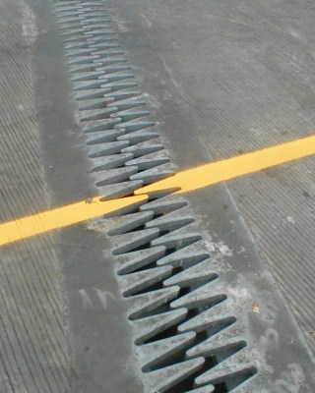
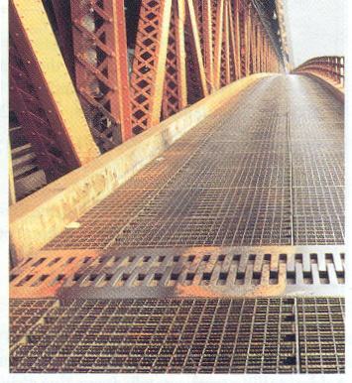
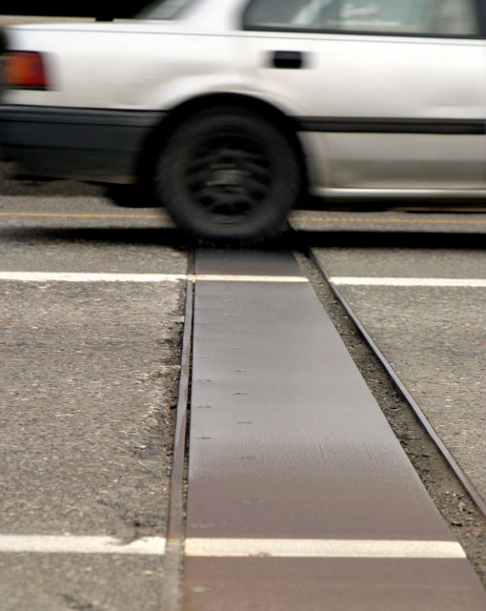
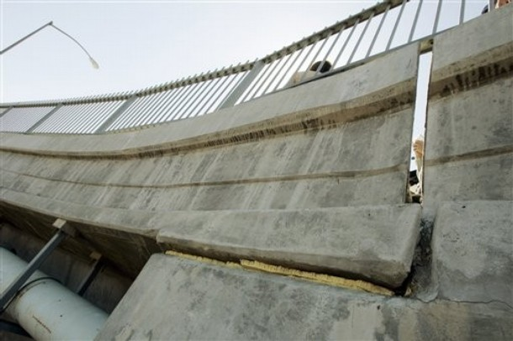
06-01 Temperature and Thermal Expansion
Even small changes in length can have serious consequences
Have you ever seen expansion joints in bridges?
Notes:
If the space is not provided for expansion, then the road/bridge would buckle

Slide 10
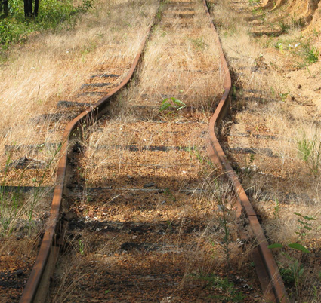

Slide 11
06-01 Temperature and Thermal Expansion
A steel bridge is 2 km long. If the temperature when it was built was 21°C (70°F), what length expansion joints are needed to prevent buckling at 43°C (110°F)?
ΔL = 0.528 m
Notes:
$$ΔL=αLΔT$$
$$ΔL=\left(12×{10}^{−6} °C^{−1}\right)\left(2000 m\right)\left(43 °C−21 °C\right)=0.528 m$$

Slide 12
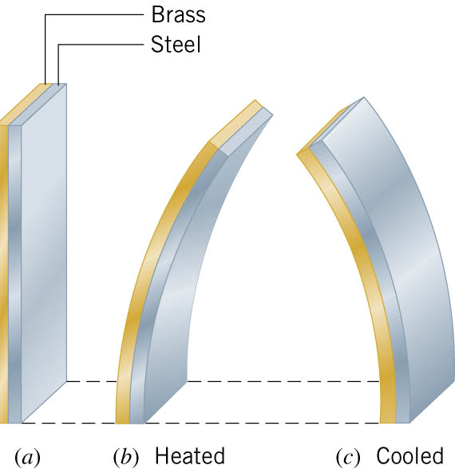
06-01 Temperature and Thermal Expansion
Bimetallic Strip
  Made from two strips of metal that have different coefficients of linear expansion
  One side expands more than the other causing the strip to bend
  Used in automatic switches in appliances and thermostats
Notes:
Coffee maker described on p344

Slide 13

06-01 Temperature and Thermal Expansion
Area thermal expansion
  $ΔA=2αAΔT$
Volume thermal expansion
  $ΔV=βVΔT$
  $β$ = coefficient of volume expansion
    Usually is about 3$α$

Slide 14
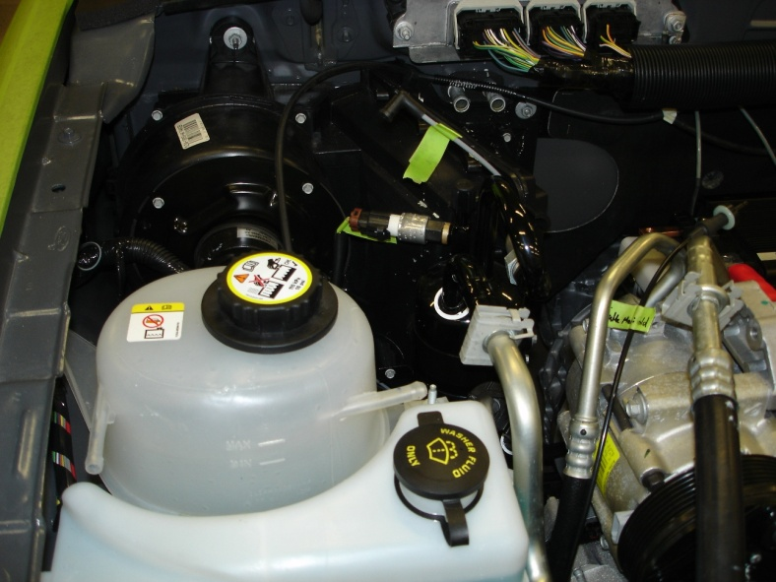
06-01 Temperature and Thermal Expansion
Why do fluids in the car usually have a reservoir tank (radiator, brake fluid, power steering fluid, oil)?
As the fluids heat, the volume increases
There needs to be some place for the extra fluid to go

Slide 15
06-01 Temperature and Thermal Expansion
Water
  Water is unique
  The volume of water decreases from 0°C to 4°C
  Then water expands from 4°C and up
  Water is the densest (least expanded) at 4°C
  As the weather gets cold, the lake water cools and sinks because it becomes more dense pushing the warmer water up
  After all the water is 4°C, the top starts to freeze
  Because the 0°C water is less dense than the 4°C water, it floats
  The ice floats and provides insulation for the warmer water underneath so it does not freeze

Slide 16
06-01 Homework
Expand your mind with these questions
Read 13.3, 13.4

Slide 17
06-02 Ideal Gas Law and Kinetic Theory
In this lesson you will…
• State the ideal gas law in terms of molecules and in terms of moles.
• Use the ideal gas law to calculate pressure change, temperature change, volume change, or the number of molecules or moles in a given volume.
• Use Avogadro’s number to convert between number of molecules and number of moles.
• Express the ideal gas law in terms of molecular mass and velocity.
• Define thermal energy.
• Calculate the kinetic energy of a gas molecule, given its temperature.
• Describe the relationship between the temperature of a gas and the kinetic energy of atoms and molecules.

Slide 18
06-02 Ideal Gas Law and Kinetic Theory
Do the lab handout.
Three stations, so rotate through them.
Station 1 – Marshmallow Syringe
Station 2 – Fire Syringe
Station 3 – Soda Can

Slide 19


06-02 Ideal Gas Law and Kinetic Theory
Coefficient of expansion $β$ is almost the same for most gases
At low densities, gas molecules are far apart so they don’t interact much
Ideal Gas Law
  $PV=NkT$
Where
  P = pressure (Pa)
  V = volume (m³)
  N = number of particles (unitless)
  k = Boltzmann’s constant = $1.38×{10}^{−23} J/K$
  T = temperature (K)

Slide 20

06-02 Ideal Gas Law and Kinetic Theory
Large number of molecules in a sample
Convenient to have a unit for a large number of things
Mole (mol)
  Actually gram-mole
  Number of atoms of C¹² in 12 grams
  Number of atoms per mole = $6.022×{10}^{23}$
  Avogadro’s number N_{A} = $6.022×{10}^{23} mol^{−1}$

Slide 21

06-02 Ideal Gas Law and Kinetic Theory
Number of moles in a sample
$$n=\frac{N}{N_{A}}$$
Where
  n = number of moles
  N = number of particles
  N_{A} = $6.022×{10}^{23} mol^{−1}$

Slide 22

06-02 Ideal Gas Law and Kinetic Theory
Number of moles can be found from mass
$$n=\frac{m}{molar mass}$$
Where
  n = number of moles
  m = mass of sample
  Molar mass = same number as atomic mass from periodic table (g/mol)

Slide 23


06-02 Ideal Gas Law and Kinetic Theory
Ideal Gas Law (moles)
$$PV=nRT$$
Where
  P = pressure (Pa)
  V = volume (m³)
  n = number of moles (mol)
  R = universal gas constant (8.31 J/(mol K)) = $N_{A}k$
  T = temperature (K)
PV is energy
  $P=\frac{F}{A}$
  $V=A⋅d$
  $PV=\frac{F}{A}A⋅d=Fd=energy$
nRT or NkT is energy too
  N and k are just numbers, so T must be energy
  T is average KE of molecules

Slide 24
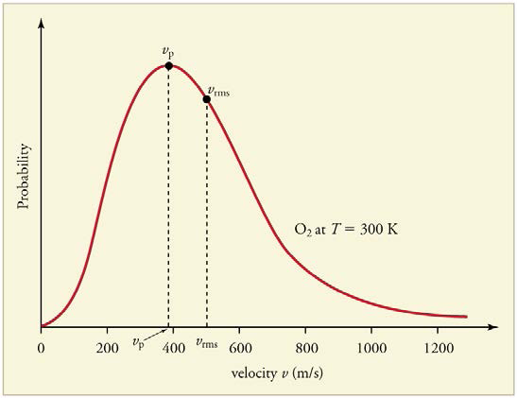

06-02 Ideal Gas Law and Kinetic Theory
$PV=NkT=\frac{1}{3}Nm{\overline{v}}^{2}$
$\overline{KE}=\frac{1}{2}m{\overline{v}}^{2}=\frac{3}{2}kT$
  $v_{rms}=\sqrt{\frac{3kT}{m}}$
  Not all the molecules go the same speed
  Higher T, means higher $v_{rms}$

Slide 25
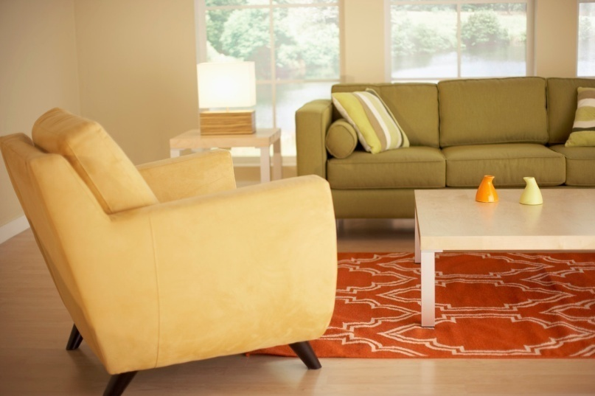

06-02 Ideal Gas Law and Kinetic Theory
An apartment has a living room whose dimensions are 2.5 m × 4.0 m × 5.0 m. Assume that the air in the room is composed of 79% nitrogen (N₂) and 21% (O₂). At a temperature of 22 °C and a pressure of $1.01×{10}^{5}$ Pa, what is the mass of the air?
m = 59430 g
  59.4 kg = 131 lbs
Notes:
$$P=1.01×{10}^{5} Pa$$
$$V=2.5 m×4.0 m×5.0 m=50 m^{3}$$
$$n= ?$$
$$R=8.31 J/mol K$$
$$T=22 °C=295 K$$
$$\left(1.01×{10}^{5} Pa\right)\left(50 m^{3}\right)=n\left(8.31\frac{J}{mol K}\right)\left(295 K\right) → n=2060 mol$$
$$n=\frac{m}{molar mass}$$
$$2060 mol=\frac{m}{\left(0.79⋅2⋅14.0067\frac{g}{mol}+0.21⋅2⋅15.9994\frac{g}{mol}\right)}$$
$$m=59430 g$$

Slide 26

06-02 Ideal Gas Law and Kinetic Theory
Helium, a monatomic gas, fills a 0.010-m³ container. The pressure of the gas is $6.2×{10}^{5}$ Pa.
  If there are 3 mol of gas, what is the temperature of the gas?
    T = 249 K
  What is the v_{rms}?
    v_{rms} = 1240 m/s
Notes:
$$PV=nRT$$
$$\left(6.2×{10}^{5} Pa\right)\left(0.010 m^{3}\right)=\left(3 mol\right)\left(8.31\frac{J}{mol}\right)T$$
$$T=248.7 K$$
$$n=\frac{m}{molar mass}=\frac{N}{N_{A}}→m=\frac{1⋅\left(4.0026\frac{g}{mol}\right)}{6.022×10^{23}\frac{}{mol}}=6.65×{10}^{−24} g=6.65×10^{−27} kg$$
$${v_{rms}=\sqrt{\frac{3kT}{m}}=v}_{rms}=\sqrt{\frac{3\left(1.38×{10}^{−23}\frac{J}{K}\right)\left(248.7 K\right)}{6.65×{10}^{−27} kg}}=1244 m/s$$

Slide 27
06-02 Homework
Ideally you should be able to answer these questions
Read 13.5, 13.6

Slide 28
06-03 Phase Changes and Humidity
In this lesson you will…
• Interpret a phase diagram.
• Identify and describe the triple point of a gas from its phase diagram.
• Describe the state of equilibrium between a liquid and a gas, a liquid and a solid, and a gas and a solid.
• Explain the relationship between vapor pressure of water and the capacity of air to hold water vapor.
• Explain the relationship between relative humidity and partial pressure of water vapor in the air.
• Calculate vapor density using vapor pressure.
• Calculate humidity and dew point.

Slide 29
06-03 Phase Changes and Humidity
Do the lab handout
Fill the flask about 1/3 full of water.
Put the flask on the heat source and bring the water to a boil.
After the water has been boiling enough to fill the top of the flask with steam, put the stopper on the flask (it will not stay because the steam is escaping).
Remove the flask from the heat (with the stopper still on).
When the water quits boiling, put the flask in the cool water. Watch the water in the flask.
What happens to the water in the flask?
How could that happen when the water is cooler?

Slide 30
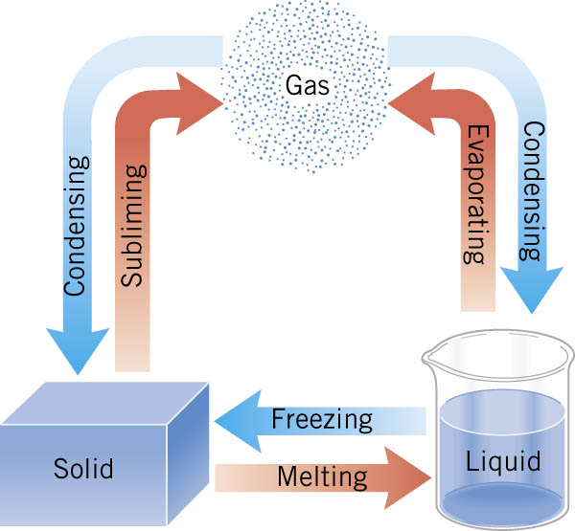
06-03 Phase Changes and Humidity
Phase Changes

Slide 31
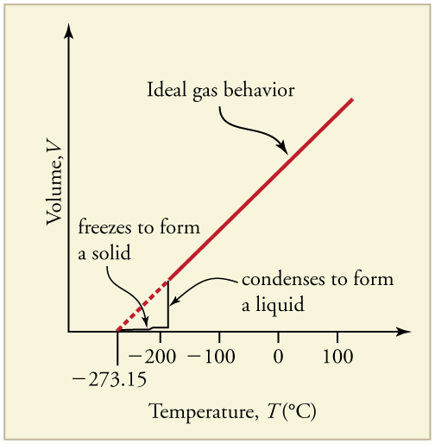
06-03 Phase Changes and Humidity
Constant Pressure
  High temps gases have ideal behavior
  Colder, volume drops and forms liquid
  Colder yet, volume drops and forms solid

Slide 32
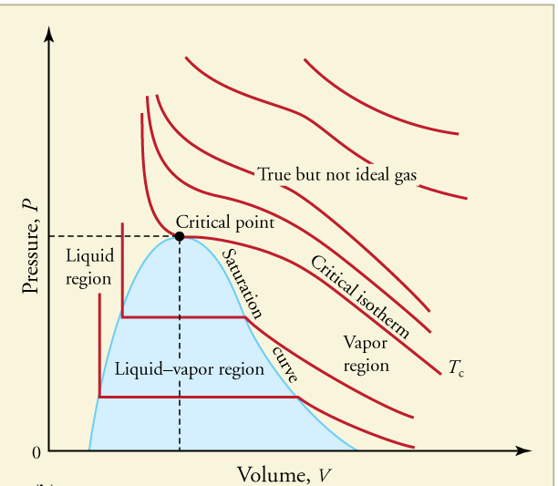
06-03 Phase Changes and Humidity
Constant Temperature (PV diagram)
  Critical Point
    Temperature above which liquid cannot exist
    Minimum pressure needed for liquid

Slide 33
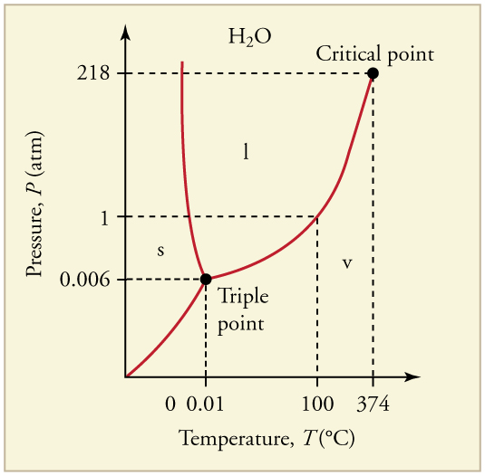
06-03 Phase Changes and Humidity
Constant Volume (phase diagram)
  Critical point
    Above this temp, no liquid
  Triple point
    All 3 phases coexist
  Lines
    2 phases coexist

Slide 34
06-03 Phase Changes and Humidity
Vapor Pressure
  The pressure at which a gas coexists with its solid or liquid phase.
  Faster molecules break away from liquid or solid to form vapor
Partial Pressure
  The pressure a gas would create if there were no other gases present.
Total pressure
  Total of all partial pressures of all gases present

Slide 35

06-03 Phase Changes and Humidity
Relative Humidity
  How much water vapor is in air
  At 100% humidity, partial pressure of water = vapor pressure
  If partial pressure < vapor pressure → evaporation
  If partial pressure > vapor pressure → condensation
Hotter means higher partial pressure of water
  Hot air can hold more water
Saturation Vapor Density
  Maximum amount of water vapor that air can hold at various temp
Percent Humidity
  $\% Relative Humidity=\frac{vapor density}{saturation vapor density}×100\%$
Notes:
PV=nRT
As air cools, partial pressure of water decreases. At dew point, partial pressure=vapor pressure and water vapor starts to condense

Slide 36

06-03 Phase Changes and Humidity
What pressure is necessary to raise the boiling point of water to 150 $°$C? If this was a sealed container, what would the gauge pressure be?
Pressure = $4.76×{10}^{5}$ Pa
Gauge pressure = $3.75×{10}^{5}$ Pa
Notes:
Pressure: from table 13.5 vapor pressure at 150 $°$C = $4.76×{10}^{5}$ Pa
Gauge pressure: $Gauge pressure=total pressure−air pressure$
$$gauge pressure=4.76×{10}^{5} Pa−1.01×{10}^{5} Pa=3.75×{10}^{5} Pa$$

Slide 37

06-03 Phase Changes and Humidity
Late on an autumn day, the relative humidity is 45.0% and the temperature is 20.0 $°$C. What will the relative humidity be that evening when the temperature has dropped to 10.0 $°$C, assuming constant water vapor density?
82.3 %
Notes:
$$\% humidity=\frac{vapor pressure}{saturation vapor pressure}×100\%$$
From table 13.5, saturation vapor pressure at$20.0 °C=17.2 g/m^{3}$
$$45\%=\frac{VP}{17.2\frac{g}{m^{3}}}×100\%$$
$$7.74\frac{g}{m^{3}}=VP$$
From table 13.5, saturation vapor pressure at$10.0 °C=9.40 g/m^{3}$
$$\% humidity=\frac{7.74\frac{g}{m^{3}}}{9.40\frac{g}{m^{3}}}×100\%$$
$$\% humiodity=82.3 \%$$

Slide 38
06-03 Homework
I hope these problems won’t make you boiling mad.
Read 14.1, 14.2

Slide 39
06-04 Heat and Temperature Change
In this lesson you will…
• Define heat as transfer of energy.
• Observe heat transfer and change in temperature and mass.
• Calculate final temperature after heat transfer between two objects.

Slide 40
06-04 Heat and Temperature Change
Heat is energy that flows from a higher-temperature object to a lower-temperature object because of the difference in temperatures
Unit: Joule (J), calorie (cal), kilocalorie (kcal or Cal)
If an object feels hot, the heat is flowing into you
If an object feels cold, the heat is flowing out of you
Mechanical Equivalent of Heat
  Since heat is energy, other types of energy can make the same effect as heat
    1.000 kcal = 4186 J
Notes:
Results when internal energy from kinetic energy of molecules is transferred
Calorie = raise 1 g of water 1 $°$C
Kilocalorie = 1000 calories = raise 1 kg of water 1 $°$C

Slide 41

06-04 Heat and Temperature Change
To increase the temperature of an object heat is required
  The amount of heat required is related to
    Mass of the object
    Amount of temperature change
    Material of the object
$Q = mcΔT$
  Q = heat
  c = specific heat capacity (based on material Table 14.1)
  m = mass
  ΔT = change in temperature

Slide 42
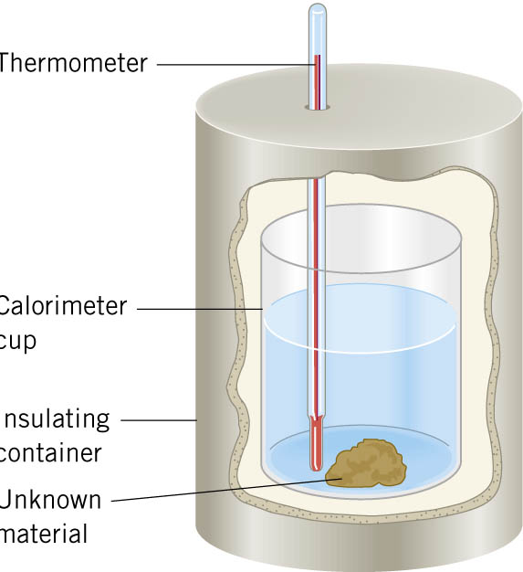
06-04 Heat and Temperature Change
Measuring the change in temperature of different heated objects (usually water and an unknown) inside a thermos can be used to measure the specific heat capacity of the object
This can be used to identify the unknown material

Slide 43
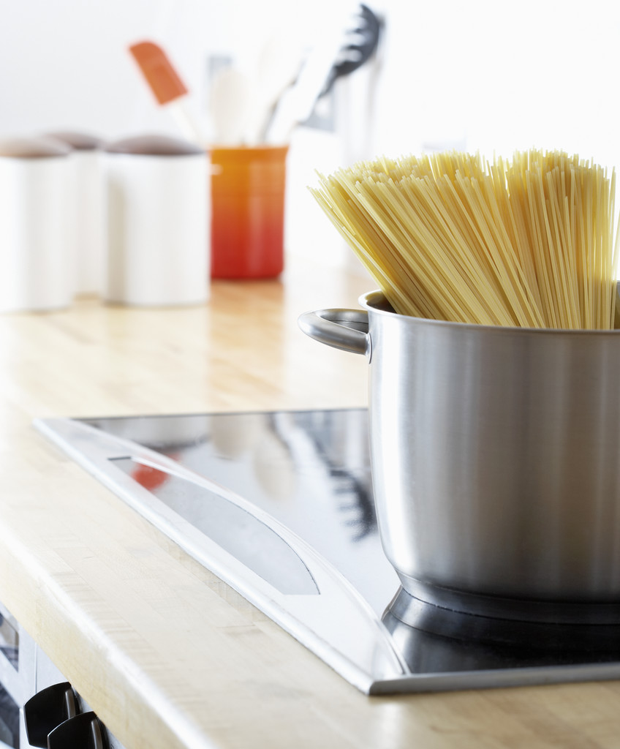

06-04 Heat and Temperature Change
A pot of 10 kg of 15-°C water is put on a stove and brought to a boil. How much heat was needed?
Q = $3.56×{10}^{6} J$
Notes:
$$Q = mcΔT$$
$$Q = \left(4186\frac{J}{kg °C}\right)\left(10 kg\right)\left(100°C−15°C\right)$$
$$Q = 3558100 J$$

Slide 44


06-04 Heat and Temperature Change
What is the increase in temperature of a 50 g nail hit by a hammer with force of 500N? The length of the nail is .06m its specific heat capacity is 450 J/kg$°$C.
$ΔT=1.33 °C$
Notes:
$$Q = mcΔT$$
$$Q=energy=work=Fs=\left(500 N\right)\left(0.06 m\right)=30 J$$
$$30 J=\left(0.050 kg\right)\left(450\frac{J}{kg°C}\right)ΔT$$
$$ΔT=1.33 °C$$

Slide 45
06-04 Heat and Temperature Change
Do the lab handout.
A hot marble will be placed into cool water. The heat will transfer from the marble into the water until they are the same temperature. The amount of heat that leaves the marble is the same as the heat absorbed by the water. By knowing the change in temperature and amount of water, we can calculate the specific heat capacity of the marble.
Where could errors have come from?
Notes:
Heat escaping to the environment.

Slide 46
06-04 Homework
How much does the temperature of your pencil rise as you do these problems?
Read 14.3

Slide 47
06-05 Phase Change and Latent Heat
In this lesson you will…
• Examine heat transfer.
• Calculate final temperature from heat transfer.

Slide 48
06-05 Phase Change and Latent Heat
Start the lab handout.
Measurements will be taken every few minutes, but we will start the lesson, then pause for the measurements.
Boiling water – Mr. Wright has the water.
Ice Water – Students have the ice water.

Slide 49
06-05 Phase Change and Latent Heat
Energy is required to (or released by) changing the molecular bonds in states of matter
It takes energy to break the crystal structure to change from solid to liquid

Slide 50
06-05 Phase Change and Latent Heat
Heat does not always change the temperature of a material
Phases of matter
  Solid
  Liquid
  Gas
Blue arrows release energy
Red arrows absorb energy
Notes:
Be sure to define the term for each change of phase

Slide 51
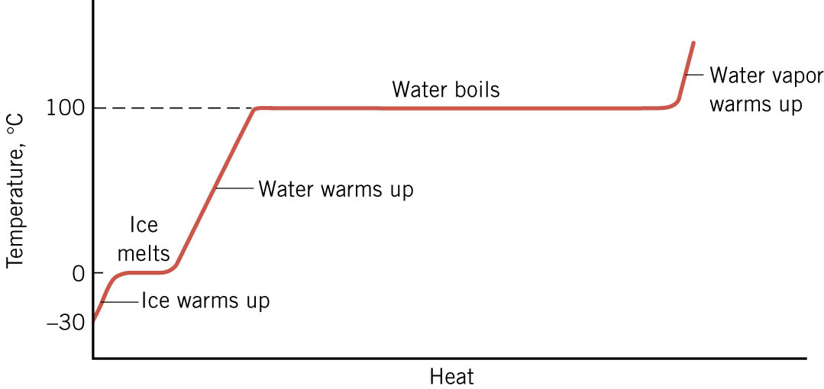
06-05 Phase Change and Latent Heat
Typical process (water)
  Ice warms up (temperature change)
  Ice melts (no temperature change until no ice)
  Water warms up (temperature change)
  Water boils (no temperature change until no liquid)
  Steam warms up

Slide 52
06-05 Phase Change and Latent Heat
When you cook pasta (or anything that requires boiling), is it better to have a vigorous boil or to turn down the heat to produce barely boiling water?
As long as the water is boiling, it is at 100°C
It is saves energy if you use barely boiling water

Slide 53

06-05 Phase Change and Latent Heat
Latent heat
  The amount of heat per kilogram required to change phase
$Q=mL$
$Q$= heat required
$m$= mass
$L$= latent heat

Slide 54
06-05 Phase Change and Latent Heat
Latent heat of fusion (L_{f})
  Refers to change between solid and liquid
Latent heat of vaporization (L_{v})
  Refers to change between liquid and gas
Latent heat of sublimation (L_{s})
  Refers to change between solid and gas
See table 14.2

Slide 55
06-05 Phase Change and Latent Heat
The effects of latent heat can be devastating
Having 100°C (212°F) on your skin is not harmful
  Have you ever stuck your hand in a hot (400°F) oven?
Why does steam (212°F) burn you?
  The steam condenses on your skin and releases all the heat of vaporization (that’s a lot of heat!)
Notes:
One winter, I was near the wood stove and bumped it with a my hand in a wet glove. The water in the glove vaporized, then that hot vapor condensed on my skin causing burns.

Slide 56
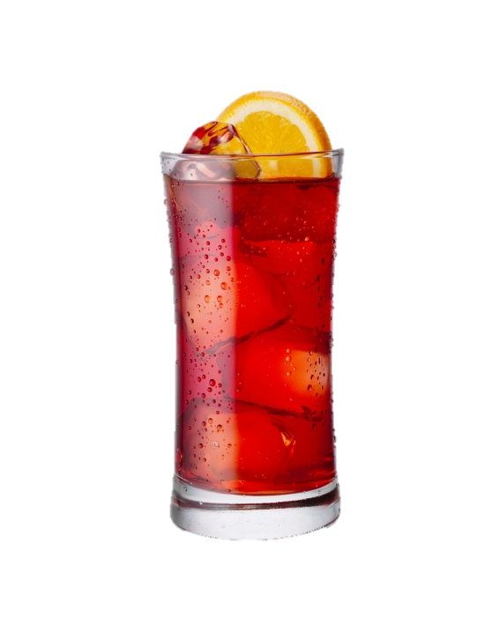
06-05 Phase Change and Latent Heat
You have a glass of 1-kg warm water (25°C). To make it cold you put in some ice cubes (-5°C). After an equilibrium temperature is reached, there is a little ice left. What is the minimum mass of the ice cubes? (Assume no heat is lost to the environment.)
m = 0.303 kg
Notes:
$$Water cools$$
$$C=4186 J/(kg°C)$$
$$m=1 kg$$
$$ΔT=T_{f}−T_{0}=0 °C−25 °C=−25 °C$$
$$Q=CmΔT=\left(4186\frac{J}{kg}°C\right)\left(1 kg\right)\left(−25 °C\right)=−104650 J$$
$$Ice warms$$
$$C=2000 J/kg°C$$
$$m=m$$
$$ΔT=0 °C− −5 °C=5 °C$$
$$Q=\left(2000\frac{J}{kg°C}\right)\left(m\right)\left(5 °C\right)=\left(10000\frac{J}{kg}\right)m$$
$$Ice melts$$
$$L_{f}=335000\frac{J}{kg}$$
$$Q=m\left(335000\frac{J}{kg}\right)$$
$$Q+Q+Q=0$$
$$−104650 J+\left(10000\frac{J}{kg}\right)m+\left(335000\frac{J}{kg}\right)m=0$$
$$\left(345000\frac{J}{kg}\right)m=104650 J$$
$$m=0.303 kg$$

Slide 57
06-05 Homework
Don’t let these problems phase you
Read 14.4, 14.5

Slide 58
06-06 Conduction
In this lesson you will…
• Discuss the different methods of heat transfer.
• Calculate thermal conductivity.
• Study thermal conductivities of common substances.

Slide 59
06-06 Conduction
Do the lab handout.
Put a small pat of butter on the curved end of each spoon.
Stick a bead to each pat of butter.
Set the spoons in the beaker with the butter side up. The handles will be downward.
Boiling water will be poured in the beaker. Predict the order that the butter will melt.

Slide 60
06-06 Conduction
Conduction
  Process where heat is transferred through a material without any movement of the material
  The objects are in contact with each other
Often happens when energetic hot molecules bump into less energetic cool molecules
  When this happens energy is transferred
Notes:
Remember the molecules of all materials are constantly moving. More motion means more energy and a higher temperature.

Slide 61
06-06 Conduction
Thermal conductors
  Materials that conduct heat well
  Metals
Thermal insulators
  Materials that conduct heat poorly
  Wood, plastic, glass

Slide 62
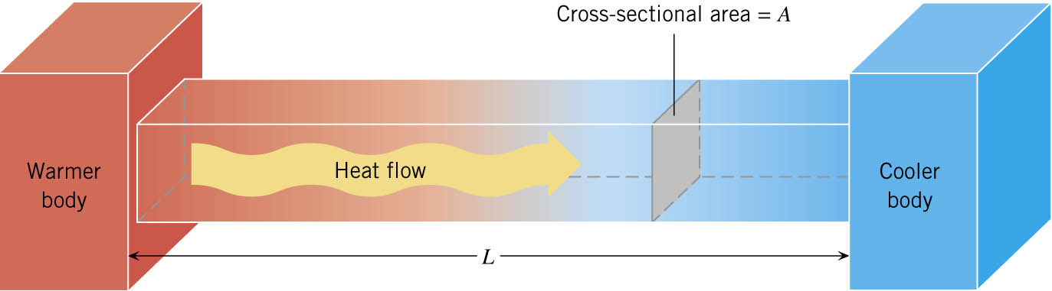

06-06 Conduction
Conduction of Heat Through a Bar
$$\frac{Q}{t}=\frac{kA\left(T_{2}−T_{1}\right)}{d}$$
  $k$= thermal conductivity (Table 14.3)
  $A$= cross-sectional area
  $T_{2}−T_{1}$= difference in temperature between ends
  $t$= time of heat transfer
  $d$= length of bar

Slide 63

06-06 Conduction
There are two ways to create good insulators
  Small k and big d
  Ratio $d/k$ called R factor
    Higher the R factor, better insulator
Other insulators like goose down and Styrofoam work by trapping air in small spaces where convection currents cannot arise

Slide 64
06-06 Conduction
How much heat is transferred through the Styrofoam insulation the walls of a refrigerator in an hour? The total area of the walls are about 4 m² and the Styrofoam is 30mm thick. The temperature inside is 5°C and the room is 25°C.
Q = 96000 J
Notes:
$$\frac{Q}{t}=\frac{kA\left(T_{2}−T_{1}\right)}{d}$$
$$\frac{Q}{3600 s}=\frac{\left(0.01\frac{J}{sm°C}\right)\left(4 m^{2}\right)\left(25 °C−5 °C\right)}{0.03 m}$$
$$Q=96000 J$$

Slide 65
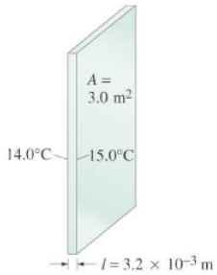

06-06 Conduction
A major source of heat loss from a house is through the windows. Calculate the rate of heat flow through a glass window 2.0 m $×$ 1.5 m in area and 3.2 mm thick, if the temperatures at the inner and outer surfaces are 15.0$°$C and 14.0$°$C, respectively.
790 J/s
Notes:
$$\frac{Q}{t}=\frac{kA\left(T_{2}−T_{1}\right)}{d}$$
$$\frac{Q}{t}=\frac{\left(0.84\frac{J}{sm°C}\right)\left(2.0 m×1.5 m\right)\left(15.0 °C−14.0 °C\right)}{3.2×{10}^{−3} m}=790 J/s$$

Slide 66
06-06 Homework
Remember to conduct yourselves as Christ-like.
Read 14.6, 14.7

Slide 67
06-07 Convection and Radiation
In this lesson you will…
• Discuss the method of heat transfer by convection.
• Discuss heat transfer by radiation.

Slide 68
06-07 Convection and Radiation
Start the lab handout. Measurements will be taken throughout class.
Heat lamps emit infrared and visible light radiation which you feel as heat. You will observe the temperature of water in three different colored bottles in front of a heat lamp.
Predict which bottle will absorb the most heat and which will absorb the least heat.

Slide 69
06-07 Convection and Radiation
Convection
  Flow of heat due to the movement of matter
  Artificial
    Circulatory system pumps blood
    Radiator pumps antifreeze
  Natural
    Difference in densities of fluids with different temperatures
    Warm air rises, cold air falls

Slide 70

06-07 Convection and Radiation
When you are working out, your sweat evaporates to cool you. How much sweat must evaporate to lower the body temperature of a 80-kg man by 1$°$C?
$m_{sweat}=0.115 kg$
Notes:
Cooling the man: $Q=m_{man}cΔT$
Evaporating the sweat: $Q=m_{sweat}L_{v\left(37°C\right)}$
No net heat loss
$$m_{man}cΔT=m_{sweat}L_{v\left(37°C\right)}$$
$$L_{v\left(37°C\right)}=2430\frac{kJ}{kg}=2.43×{10}^{6}\frac{J}{kg}$$
$$\left(80 kg\right)\left(3500\frac{J}{kg⋅°C}\right)\left(1 °C\right)=m_{sweat}\left(2.43×{10}^{6}\frac{J}{kg}\right)$$
$$m_{sweat}=0.115 kg$$

Slide 71

06-07 Convection and Radiation
One winter day, the climate control system of a large university classroom building malfunctions. As a result, 250 m³ of excess cold air is brought in each minute. At what rate in kilowatts must heat transfer occur to warm this air by 10.0$°$C (that is, to bring the air to room temperature)?
38.8 kW
Notes:
$$P=\frac{Q}{t}=\frac{mcΔT}{t}$$
$$m=ρV$$
$$m=\left(1.29\frac{kg}{m^{3}}\right)\left(250 m^{3}\right)=322.5 kg$$
$$P=\frac{\left(322.5 kg\right)\left(721\frac{J}{kg⋅°C}\right)\left(10.0 °C\right)}{60.0 s}=3.88×{10}^{4} W=38.8 kW$$

Slide 72

06-07 Convection and Radiation
Wind chill
  Air feels colder when wind is blowing because heat is removed by convection as well as conduction.
  See table 14.4
At what temperature does still air cause the same chill factor as 2$°$C air moving at 5 m/s?
Notes:
From table: -7$°$C

Slide 73

06-07 Convection and Radiation
Heat from the sun reaches earth without contact (conduction) or movement of a fluid (convection)
The energy is transferred by electromagnetic waves

Slide 74

06-07 Convection and Radiation
Radiation
  Transfer of energy via electromagnetic waves
  Electromagnetic waves include radio waves, microwaves, x-rays, infrared, and visible light

Slide 75
06-07 Convection and Radiation
All bodies (objects) continually emit radiation
  Bodies like ice cubes emit very little radiation
  Warm bodies, like human bodies, emit infrared radiation
  When the temperature of a body reaches 1000K, it starts to emit visible dull red light
  When the temperature of a body reaches 1700K, it emits white-hot light

Slide 76
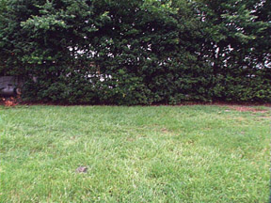
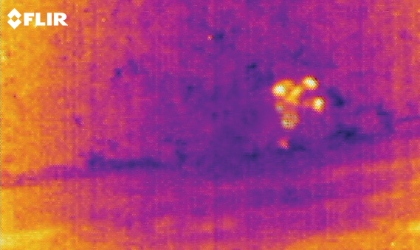
06-07 Convection and Radiation

Slide 77
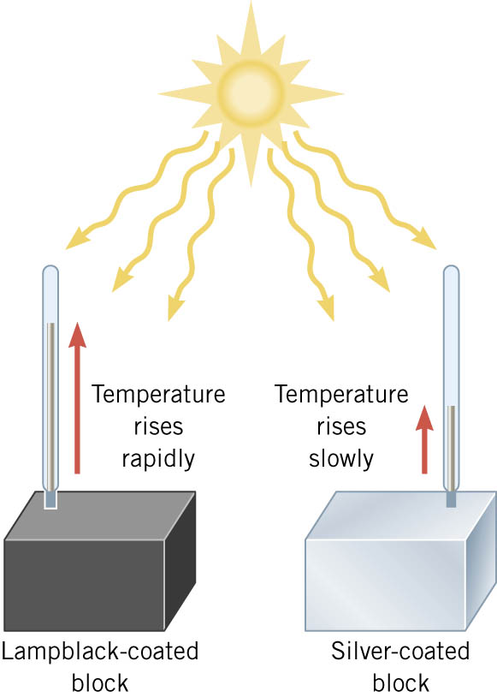
06-07 Convection and Radiation
Different objects react differently to radiation
Black box absorbs most of radiation
Silver box absorbs little radiation
The rest of the radiation is reflected

Slide 78
06-07 Convection and Radiation
Black is usually a good absorber of radiation
Blackbody is an object that absorbs all radiation that hits it
All objects emit and absorb radiation continually
  Good absorbers are also good emitters

Slide 79
06-07 Convection and Radiation
On a sunny summer day, wear light colored clothes
Black clothes absorb the sun’s radiation
  Then it re-emits the energy
  Half of the re-emitted energy is on the inside of the shirt into you
Light colored clothes absorb, and re-emit, much less radiation

Slide 80


06-07 Convection and Radiation
Stefan-Boltzmann Law of Radiation
$$\frac{Q}{t}=σeAT4$$
$\frac{Q}{t}$ = rate of heat transfer
$σ$= 5.67x10⁻⁸ J/(s m² K⁴)
$e$ = emissivity (% of radiation emitted as compared to a perfect emitter)
$A$= surface area
$T$= temperature in Kelvin
Because heat is both emitted and absorbed at the same time, the net rate of heat transfer by radiation is
$$\frac{Q}{t}=σeA\left(T_{2}^{4}−T_{1}^{4}\right)$$
$T_{1}$ = temperature of object
$T_{2}$ = temperature of surrounding
e = emissivity of object
A = surface are of object
Notes:
e depends on material
σ is the Stefan-Boltzmann constant

Slide 81
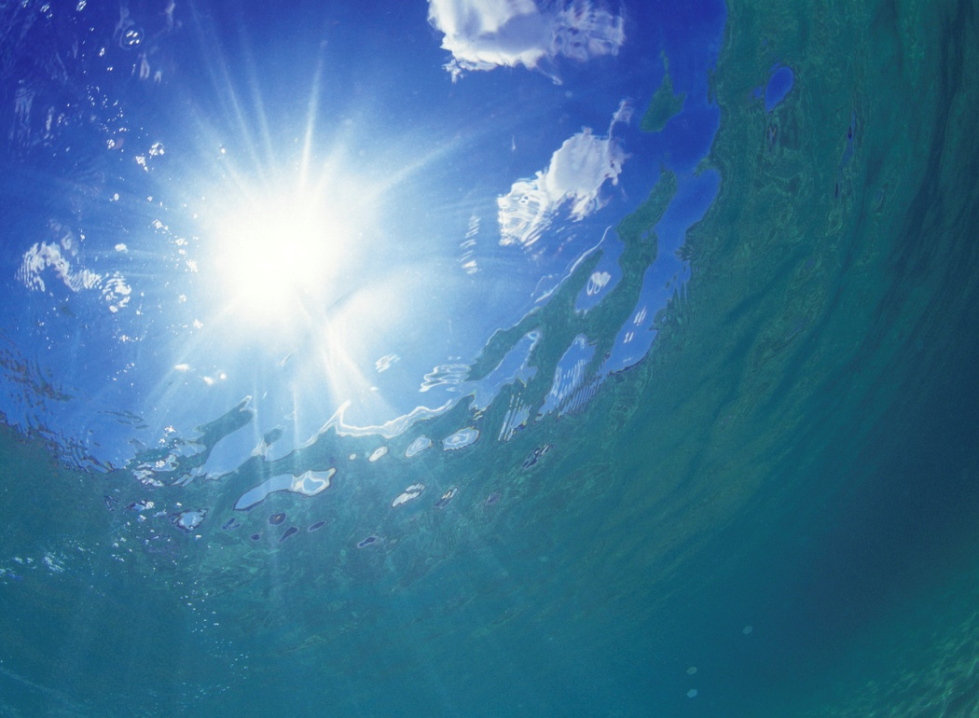

06-07 Convection and Radiation
Find the rate that heat is radiated by the sun if the surface temperature is 6000K and emissivity = 1.
$\frac{Q}{t}=4.13×{10}^{26} W$
Notes:
$$\frac{Q}{t}=σeAT4$$
$$rsun =6.69×{10}^{8} m, A=4π{\left(6.69×{10}^{8} m\right)}^{2}=5.6242×{10}^{18} m^{2}$$
$$\frac{Q}{t} =\left(5.67×{10}^{−8}\frac{J}{sm^{2}K^{4}}\right)\left(1\right)\left(5.6242×{10}^{18} m^{2}\right){\left(6000 K\right)}^{4}=4.13×{10}^{26} J/s$$

Slide 82


06-07 Convection and Radiation
Find rate that heat is radiated from a bald head if we estimate that it is a sphere with radius 120 mm and emissivity of 0.97. (Body temperature is 37.0°C and the surrounding room is at 20$°$C)
$\frac{Q}{t}=−18.6 W$
Notes:
$$\frac{Q}{t}=σeA\left(T_{2}^{4}−T_{1}^{4}\right)$$
$$\frac{Q}{t}=\left(5.67×{10}^{−8}\frac{J}{sm^{2}K^{4}}\right)\left(0.97\right)\left(4π{\left(0.12 m\right)}^{2}\right)\left({\left(293.15 K\right)}^{4}−{\left(310.15 K\right)}^{4}\right)$$
$$\frac{Q}{t}=−18.6\frac{J}{s}$$

Slide 83
06-07 Homework
Your radiant face conveys happiness at the thought of these problems.
Read 15.1, 15.2

Slide 84
06-08 The 1st Law of Thermodynamics and Simple Processes
In this lesson you will…
• Define the first law of thermodynamics.
• Describe how conservation of energy relates to the first law of thermodynamics.
• Calculate changes in the internal energy of a system, after accounting for heat transfer and work done.
• Describe the processes of a simple heat engine.
• Explain the differences among the simple thermodynamic processes—isobaric, isochoric, isothermal, and adiabatic.
• Calculate total work done in a cyclical thermodynamic process.

Slide 85
06-08 The 1st Law of Thermodynamics and Simple Processes
Thermodynamics is study of laws of heat transfer and its relationship to work

Slide 86
06-08 The 1st Law of Thermodynamics and Simple Processes
Systems have internal energy due to the KE and PE of the particles in it
Heat can be gained by the system
  Because of conservation of energy this changes the internal energy of the system
  Heat is positive when system gains heat
  Heat is negative when system loses heat

Slide 87
06-08 The 1st Law of Thermodynamics and Simple Processes
Work can also change internal energy of a system
  Work is positive when it is done by the system
  Work is negative when it done on the system
Remember the internal energy of the system only depends on the state of the system; not how it got that way

Slide 88

06-08 The 1st Law of Thermodynamics and Simple Processes
1st Law of Thermodynamics
  $ΔU=Q−W$
  Where
    U = internal energy = $\frac{3}{2}NkT$ for ideal gas
    Q = heat (positive when system gains Q)
    W = work (positive when system does W)

Slide 89
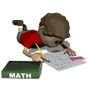
06-08 The 1st Law of Thermodynamics and Simple Processes
While working on an assignment, Frank does 10000 J of work. In the process, his internal energy decreases by 20000 J. Find W, ΔU, and Q.
W = 10000 J
ΔU = -20000 J
Q = -10000 J
Notes:
W is positive since it is work done by the system
ΔU is negative since the internal energy decreases
$$ΔU=Q−W$$
$$−20000 J=Q−10000 J$$
$$Q=−10000 J$$
System loses lots of heat.

Slide 90
06-08 The 1st Law of Thermodynamics and Simple Processes
Four thermal processes
  Each is quasi-static → slow enough that uniform temperature and pressure

Slide 91
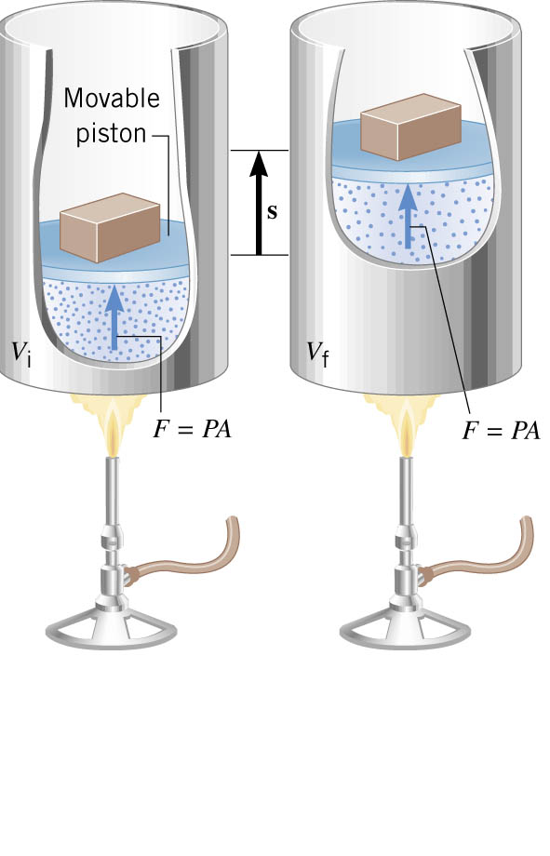
06-08 The 1st Law of Thermodynamics and Simple Processes
Isobaric
  Constant pressure
  Frictionless piston where the pressure is determined by the weight of the piston (doesn’t change)
  As the gas is heated, it expands and pushes the piston up
  W = Fs
Notes:
“Iso” means same
“Bar” means pressure “barometer”

Slide 92
06-08 The 1st Law of Thermodynamics and Simple Processes
Isobaric
  W = Fs
  F = PA
  W = (PA)s
  As = ΔV = V_{f} – V_{i}
  W = P ΔV = P(V_{f} – V_{i})
  This is valid for all states of matter

Slide 93
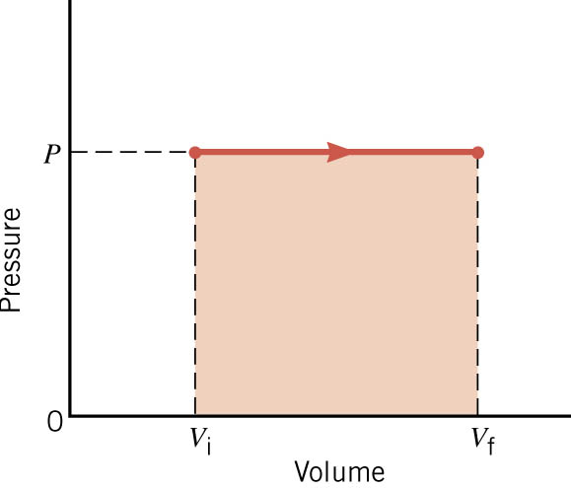
06-08 The 1st Law of Thermodynamics and Simple Processes
Isobaric
  Graph of V vs P
  W = PΔV = area under graph

Slide 94
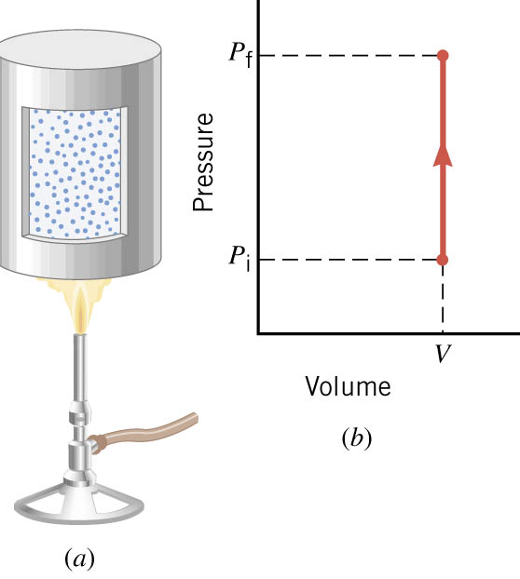
06-08 The 1st Law of Thermodynamics and Simple Processes
Isochoric
  Constant volume
  Since no change in volume no work is done
  1st law of thermodynamics for isochoric processes
    ΔU = Q – W, but W = 0
    ΔU = Q

Slide 95

06-08 The 1st Law of Thermodynamics and Simple Processes
Isothermal
  Constant temperature
  Usually temperature of a gas decreases as it (PV=nRT) expands, so thermal energy is transferred into the gas from the environment
  $Q=W$

Slide 96
06-08 The 1st Law of Thermodynamics and Simple Processes
Adiabatic
  No heat transfer
  1st law of thermodynamics becomes
    ΔU = Q – W, but Q = 0
    ΔU = – W

Slide 97
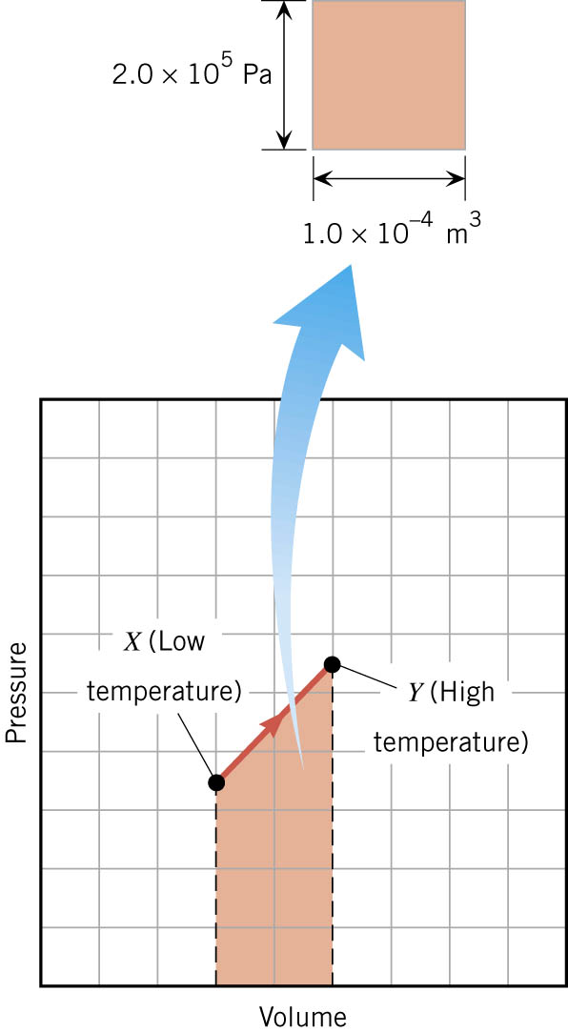
06-08 The 1st Law of Thermodynamics and Simple Processes
Sometimes it is hard to determine the type of process
A graph can help
The area under a Pressure-Volume graph is the work
Notes:
If volume increases W is +

Slide 98
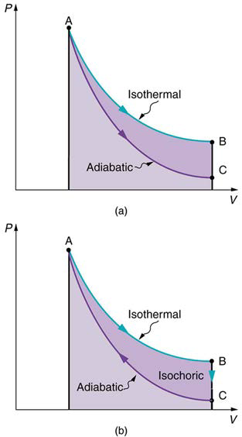
06-08 The 1st Law of Thermodynamics and Simple Processes
If the process goes in a loop, then the work done is the area inside the loop on a PV graph
Notes:
The bottom portion cancels out
In this graph
Isothermal is positive W
Adiabatic is negative W since the $Δ$V is negative

Slide 99
06-08 The 1st Law of Thermodynamics and Simple Processes
Since the work can be positive or negative, the processes can go either direction
In theory it can be completely reversed (return to previous state)
There is always friction so there is never completely reversible process

Slide 100
06-08 Homework
I expect you to change the internal energy of the paper by doing work on it
Read 15.3, 15.4, 15.5

Slide 101
06-09 The 2nd Law of Thermodynamics and Heat Engines
In this lesson you will…
• State the expressions of the second law of thermodynamics.
• Identify a Carnot cycle.
• Describe the use of heat engines in heat pumps and refrigerators.
• Demonstrate how a heat pump works to warm an interior space.
• Explain the differences between heat pumps and refrigerators.
• Calculate a heat pump’s coefficient of performance.

Slide 102
06-09 The 2nd Law of Thermodynamics and Heat Engines
Deals with spontaneous processes
Heat spontaneously moves from high temp to low

Slide 103


06-09 The 2nd Law of Thermodynamics and Heat Engines
Heat Engine
  Uses part of the spontaneous heat transfer to do work
  $W=Q_{h}−Q_{c}$
Efficiency
  $Eff=\frac{W}{Q_{h}}$
  $=\frac{Q_{h}−Q_{c}}{Q_{h}}$
  $=1−\frac{Q_{c}}{Q_{h}}$
Only 100% efficient if no heat goes to environment
Notes:
$Q_{c}$ is heat sent to environment

Slide 104

06-09 The 2nd Law of Thermodynamics and Heat Engines
Stated in terms of reversible processes, the second law of thermodynamics has another form:
A Carnot engine operating between two given temperatures has the greatest possible efficiency of any heat engine operating between these two temperatures.
Furthermore, all engines employing only reversible processes have this same maximum efficiency when operating between the same given temperatures.
$Eff=1−\frac{T_{c}}{T_{h}}$

Slide 105
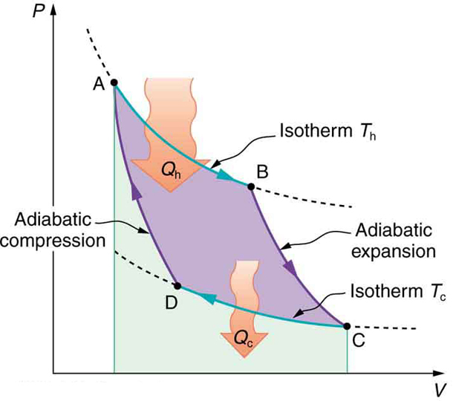
06-09 The 2nd Law of Thermodynamics and Heat Engines
Carnot Engines use only reversible processes

Slide 106
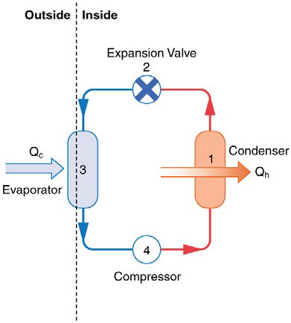
06-09 The 2nd Law of Thermodynamics and Heat Engines
Heat Pumps
  Use Carnot cycle to move heat from low temp to high
  1. Gas at high temp/pressure in condenser, so heat goes to room
  2. Valve lowers temp/pressure turning gas to liquid
  3. Heat from cold area is used to evaporate liquid
  4. Compressor raises temp/pressure of gas

Slide 107


06-09 The 2nd Law of Thermodynamics and Heat Engines
Heat pump
  Coefficient of Performance
  $COP_{hp}=\frac{Q_{h}}{W}$
  $=\frac{1}{Eff}$
Low Eff means high COP
For a Carnot engine
  $Eff=1−\frac{T_{c}}{T_{h}}$
  Lowest $Eff$ when $T_{c}≈T_{h}$
  Heat pumps work best when small temp difference

Slide 108
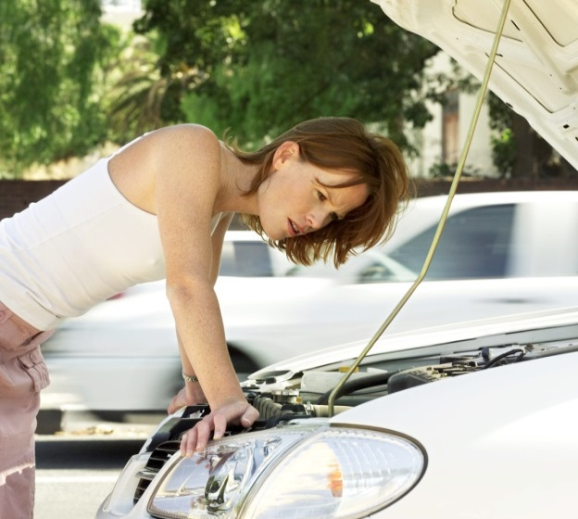

06-09 The 2nd Law of Thermodynamics and Heat Engines
An automobile engine has an efficiency of 20% and produces an average of 23,000 J of mechanical work per second during operation. (a) How much heat input is required, and (b) how much heat is discharged as waste heat from this engine per second?
$Q_{h}=115 kJ$
$\frac{Q_{c}}{s}=92 kW$
Notes:
$$Eff=\frac{W}{Q_{h}}$$
$$0.20=\frac{23000 J}{Q_{h}}$$
$$Q_{h}=\frac{\left(23000 J\right)}{\left(0.20\right)}=1.15×{10}^{5} J$$
$$Eff=1−\frac{Q_{c}}{Q_{h}}$$
$$0.20=1−\frac{Q_{c}}{1.15×{10}^{5} J}$$
$$0.20−1=−\frac{Q_{c}}{1.15×{10}^{5} J}$$
$$\left(−0.80\right)\left(−1.15×{10}^{5} J\right)=Q_{c}$$
$$Q_{c}=92000 J$$
$$Rate=92\frac{kJ}{s}=92 kW$$

Slide 109

06-09 The 2nd Law of Thermodynamics and Heat Engines
Refrigerators and Air Conditioners
Similar to heat pump, but designed to cool
$$COP_{ref}=\frac{Q_{c}}{W}$$
Since $Q_{h}=Q_{c}+W$,
$$COP_{ref}=COP_{hp}−1$$

Slide 110
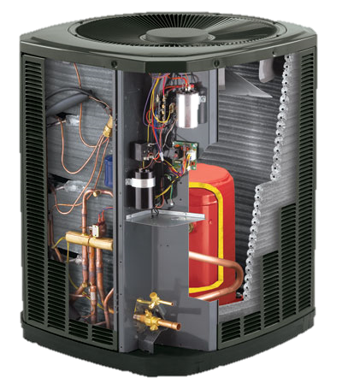

06-09 The 2nd Law of Thermodynamics and Heat Engines
A heat pump has a coefficient of performance of 3.0 and is rated to do work at 1500 W. (a) How much heat can it add to a room per second? (b) If the heat pump were turned around to act as an air conditioner in the summer, what would you expect its coefficient of performance to be?
$Q_{h}=4500 J$
$COP_{ref}=2.0$
Notes:
$$COP=\frac{Q_{h}}{W}$$
Every second, W=1500 J since P=W/t
$$3.0=\frac{Q_{h}}{1500 J}$$
$$Q_{h}=3.0\left(1500 J\right)=4500 J$$
$$W=Q_{h}−Q_{c}$$
$$1500 J=4500 J−Q_{c}$$
$$Q_{c}=4500 J−1500 J=3000 J$$
$$COP_{ref}=\frac{Q_{c}}{W}$$
$$COP_{ref}=\frac{3000 J}{1500 J}=2.0$$

Slide 111
06-09 Homework
Pump out some work about heat
Read 15.6, 15.7

Slide 112
06-10 Entropy and the 2nd Law of Thermodynamics
In this lesson you will…
• Define entropy and calculate the increase of entropy in a system with reversible and irreversible processes.
• Explain the expected fate of the universe in entropic terms.
• Calculate the increasing disorder of a system.
• Identify probabilities in entropy.
• Analyze statistical probabilities in entropic systems.

Slide 113

06-10 Entropy and the 2nd Law of Thermodynamics
Entropy
  Amount of energy not available for work
  Related to amount of disorder
$ΔS=\frac{Q}{T}$
  $ΔS$ = change in entropy
  Q = heat transfer
  T = temperature

Slide 114

06-10 Entropy and the 2nd Law of Thermodynamics
2nd Law of Thermodynamics
  The total entropy of a system either increases or remains constant for any process; it never decreases.
Spontaneous processes always result in
  increase of entropy
  less energy available to do work
  $W_{unavail}=ΔS⋅T_{0}$

Slide 115
06-10 Entropy and the 2nd Law of Thermodynamics
1200 J of heat flowing spontaneously through a copper rod from a hot reservoir 650 K to a cold reservoir at 350 K. Determine the amount by which this irreversible process changes the entropy of the universe, assuming that no other changes occur.
1.6 J/K
Notes:
$$ΔS=\frac{Q_{h}}{T_{h}}+\frac{Q_{c}}{T_{c}}$$
$$ΔS=\frac{−1200 J}{650 K}+\frac{1200 J}{350 K}=1.6\frac{J}{K}$$

Slide 116

06-10 Entropy and the 2nd Law of Thermodynamics
Find the change in entropy that results when a 2.3-kg block of ice melts slowly (reversibly) at 273 K (0 $°$C)
$2.8×{10}^{3} J/K$
Notes:
$$ΔS=\frac{Q}{T}=\frac{mL_{f}}{T}$$
$$ΔS=\frac{\left(2.3 kg\right)\left(3.35×{10}^{5}\frac{J}{kg}\right)}{273 K}=2.8×{10}^{3}\frac{J}{K}$$

Slide 117
06-10 Entropy and the 2nd Law of Thermodynamics
Origins of Life
  If the entropy (or disorderliness) increases, how do evolutionists justify evolution (more orderly)?
    Need for something since they start by assuming God doesn’t exist
    When energy is put into something, it can decrease entropy for that thing, but total entropy of universe increases
    They claim the sun gave energy to earth which allowed for life to spontaneously appear
      This would mean spontaneously making something that absorbs energy to do unspontaneous processes (making less entropy)
      This has never been duplicated in a lab

Slide 118
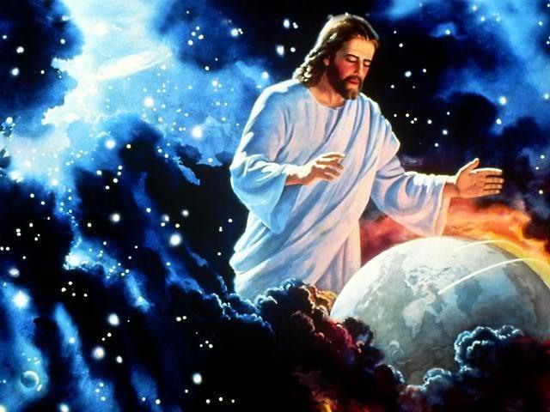
06-10 Entropy and the 2nd Law of Thermodynamics
    We use a similar idea, only we say God gave the energy and created highly organized creation
      Ever since then, the creation has been falling apart

Slide 119
06-10 Entropy and the 2nd Law of Thermodynamics
Why do spontaneous processes not decrease entropy?
  A system can have several parts
  All those parts have several ways they can be
  Much more common to get less organized combinations
Flip 5 coins
  Macrostates
    5 heads
    4 heads, 1 tail
    3 heads, 2 tails
  Microstates
    HHHHH
    HHHHT, HHHTH, HHTHH, HTHHH, THHHH

Slide 120

06-10 Entropy and the 2nd Law of Thermodynamics
Entropy
  $S=k\ln{W}$
  $k=1.38×{10}^{−23}\frac{J}{K}$ Boltzmann’s constant
  W = number of microstates in system
Using these statistics, life spontaneously developing is essentially impossible.
  They say that since life exists, it must have happened
  We say God made it happen
Notes:
Whether or not you believe in God, you can be a good experimental scientist.

Slide 121
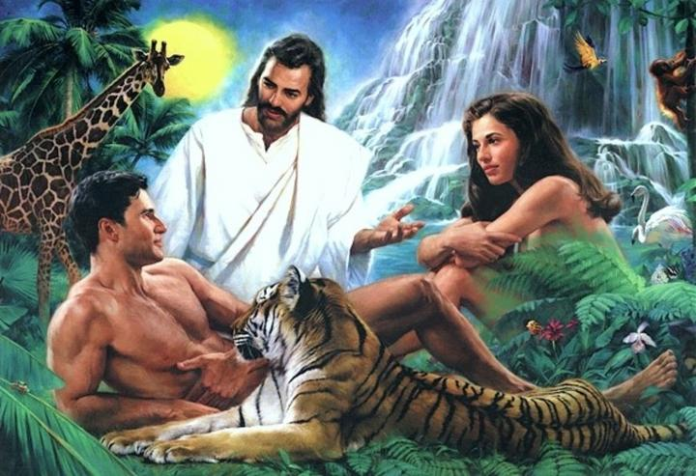

Slide 122
06-10 Entropy and the 2nd Law of Thermodynamics
Do the lab handout.
Entropy is the measure of the amount of energy unavailable to do work. Since energy is always lost in any process, the entropy always increases. Boltzmann suggested that entropy is a measure of the disorderliness of the universe. This is because disorder is far more probable than order when there is randomness.

Slide 123
06-10 Homework
Help bring order to a disorderly universe.

